Slide 1
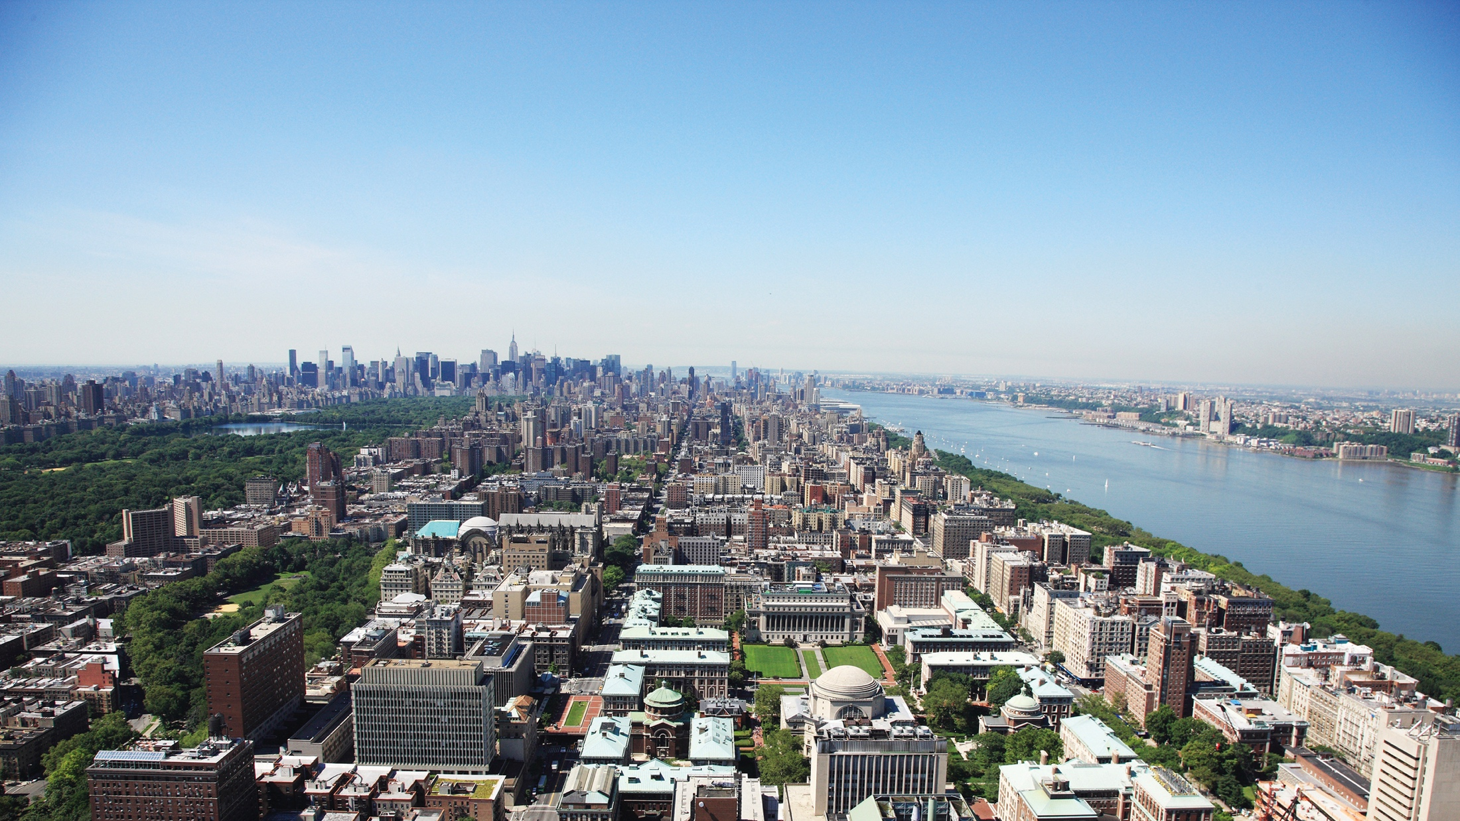
Integrated Air Quality Predictor with Universal Differential Equations
Final Project Proposal for EAEE4000 Machine Learning course
Presenter: Tianxiao Shen
TRANSCENDING DISCIPLINES, TRANSFORMING LIVES

Slide 2
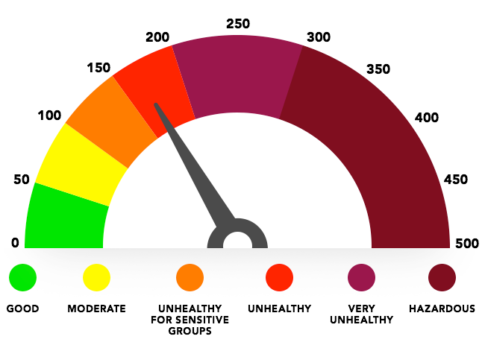
Introduction
Air Quality Index (AQI)
Important indicator for air quality
Contains three major aspects:
– Particulate Matter (PM2.5/PM10)
– SO₂
– NO_{x}
The pollutant in the highest category is chosen to be the principle pollutant, which decides the value of AQI.

Slide 3
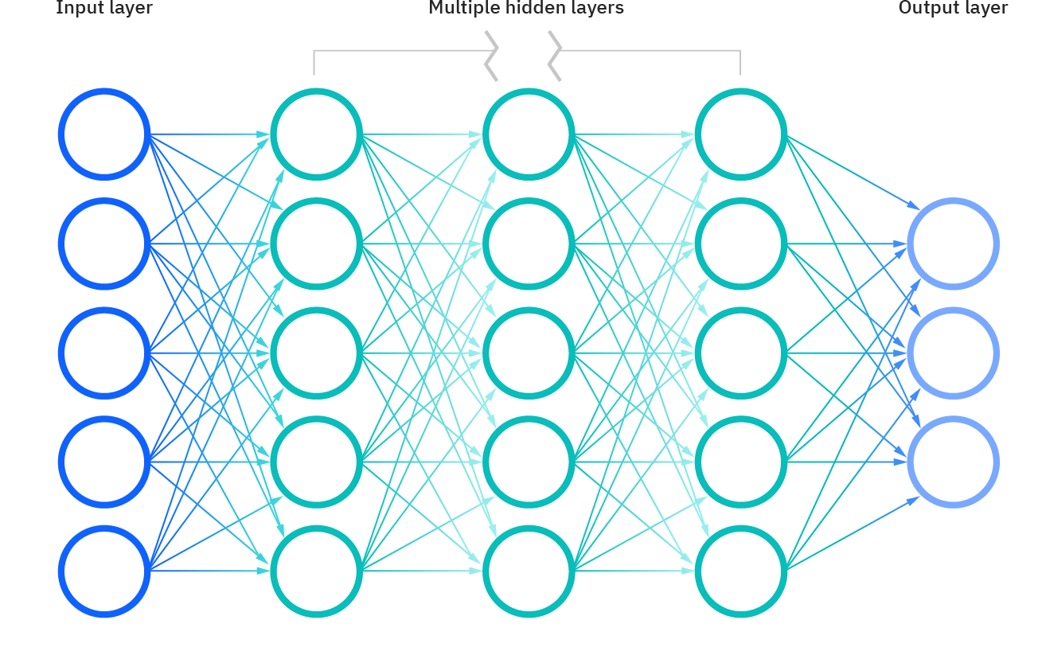
Introduction
Current AQI Forecast with ML
PM2.5
Historical AQI Data
Weather Data
Predicted
AQI Data
SO₂
NO_{x}
Only able to explain the diffusion of pollutants

Slide 4
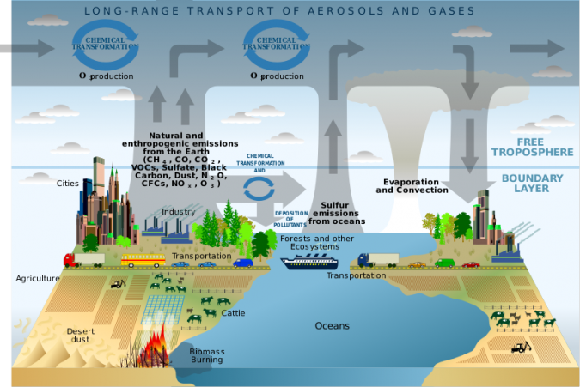
Introduction
Actually, the air quality model should contain four important aspects of pollutants:
Diffusion
Emission
Atmospheric Photochemical Reaction
Transportation
To apply these known mechanics,

Slide 5
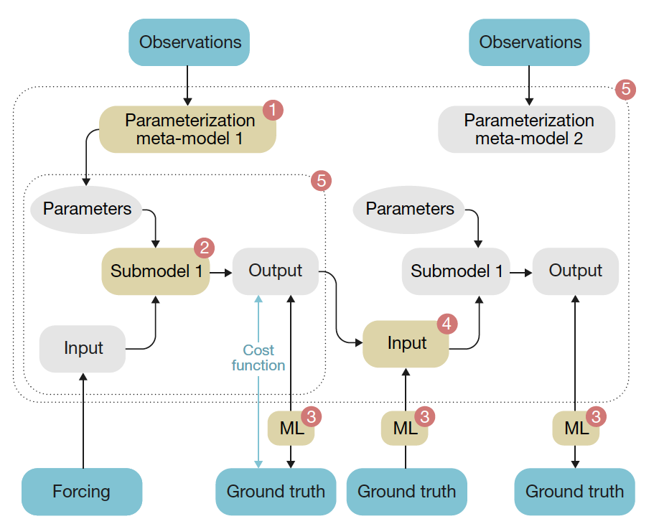
Method
Universal Differential Equations (UDEs) https://sciml.ai/
A flexible combination of neural networks
Applies all possible prior knowledge to reduce the demand for training data
Uses differentiable programming to minimize the calculation workload
Capable of explaining various mechanisms in a single ML framework.
(M. Reichstein et al., 2019)

Slide 6
UDEs Structure and Involved Data
Effect of sources and sinks
Effect of changing
diffusion condition
Q_{Emission}
A neural network representing emission of pollutants
Input data:
Automated Traffic Volume Counts
Emission factor of factories
Electricity and gas consumption
Q_{Transportation}
A neural network representing importation and exportation of pollutants
Input data:
Concentration of air pollutants
Wind speed and wind direction
AQI, direction and distance of surrounding aeras

Slide 7
UDEs Structure and Involved Data
Effect of sources and sinks
Effect of changing
diffusion condition
Q_{Reaction}
A neural network representing the photochemical reaction in the atmosphere
Input data:
Solar radiation and cloud cover ratio
Concentration of air pollutants and precursors
Potential reaction mechanisms
E_{Diffusion}
A neural network representing the diffusion coefficient of the air
Input data:
Weather conditions
Atmospheric stability
Height of boundary layer

Slide 8
UDEs Structure and Involved Data
Variables
C_{P} Concentrations of three pollutants in AQI
W Weather Conditions
S Solar Radiation Conditions
X_{E} Indicators of Emissions
X_{Q} Pollutant Concentrations in Surrounding Aeras
Datasets and Sources
AQI and Principal Pollutants of NYC from 2012 to 2019
USEPA and NYC Open Data
Historical Hourly Weather Data of NYC from 2012 to 2017
Kaggle
Physical Solar Model (PSM) version 3 from 2010 to 2017
National Solar Radiation Database
Automated Traffic Volume Counts of NYC from 2011 to 2020
New York City Department of Transportation
Hourly Energy Consumption in NYC from 2010 to 2021
US Department of Energy
Historical Pollutant Concentration in sites in New York State
USEPA

Slide 9
Objective for the project
Data and calculation efficiency of UDEs
Improvement in accuracy of AQI forecasts by UDEs
(Ability to predict extreme AQI values and early warn air pollution events)
(Robustness to certain stochastic error)

Slide 10
Plan for Project
Use the data in NYC as example, conduct the UDEs for Integrated Air Quality Predictor
Conduct RNN with same data used in UDEs to compare their efficiencies
Conduct RNN with only weather and historical AQI data, to derive the accuracy improvement of implementing UDEs and prior knowledge
(Train the UDEs with extreme data, and test its ability to react to extreme situations)
(Add random errors to the training)

Slide 11
Thank you!

